Slide 1
Post Installation Pipe Inspection Training Course & Pipe Inspection Contractor Certification Program
Prepared for the
Kentucky Transportation Cabinet
by
Kean H. Ashurst Jr., P.E.
Kentucky Transportation Center

Slide 2
Training Course
For KYTC personnel
Topics covered
Inspection standards
Types of inspections
Inspection technology
Inspection process
Defects & distresses
Inspection report requirements and review
Pay deduction examples

Slide 3
Training Course Highlights
Section 701
Inspection of pipe
Payment deduction tables
KM 64-114
Equipment requirements
Pipe inspection procedures
Report requirements

Slide 4
Training Course Highlights
Section 701.03.08
Min. 250 LF of pipe and ADT > 1000
100% of pipes under pavement
50% of pipes not under pavement
To be chosen by Section Engineer
Priorities
Culvert
Storm sewer
Outlet runs
Entrance pipes chosen last to complete footage req.
Must complete entire run – junction to junction

Slide 5
Training Course Highlights
Section 701.03.08 Continued
Rigid pipe deductions (installed pipe)
Crack width > 0.1 inch = Remediate or Replace
Flexible pipe deductions for deflection
0% to 5.0% = 100% unit bid price
5.1% to 7.5% = 75% unit bid price
7.6% to 9.9% = 50% unit bid price
10% or greater = Remove and replace
All pipe with deflections between 5% and 10% require evaluation by engineer
Special circumstances pipes with deflections greater than 10% may be allowed to remain in place
public’s best interest, structural analysis, no pay

Slide 6
Training Course Highlights
Section 701.03.08 Continued
Deduction applied to whole stick of pipe
Example: If max deflection is between 7.6% and 9.9% then that 20 foot stick is 50% of unit bid
Cracking and Deflection…that’s not all
Look for other distresses that indicate improper installation or damaged pipe
Inspecting contractor should identify all distresses so you may make an informed decision

Slide 7
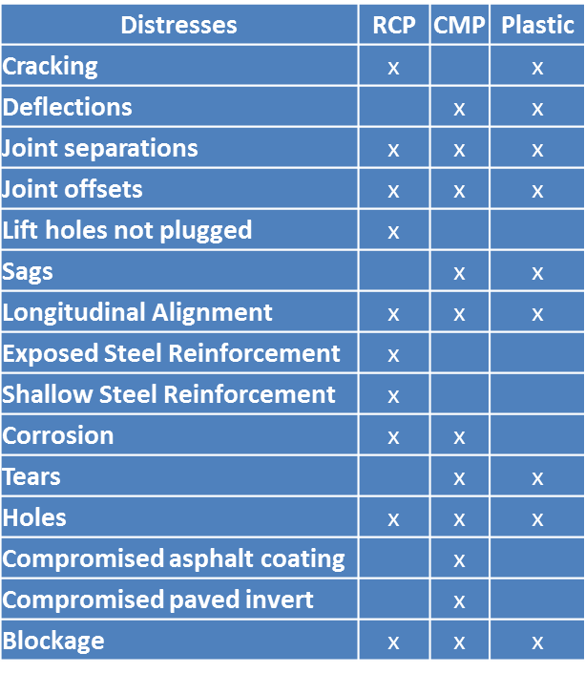
Common Distresses

Slide 8
Training Course Highlights
What you should be receiving from contractor
2 types of inspections = 2 types of reports
Video Inspection Report
Deflection Inspection Report
2 paper copies need to be provided by contractor
1 to Section Engineer
1 to Central Office
1 digital copy need to be provided by contractor
Thumb drive
DVD
Portable Hard Drive

Slide 9
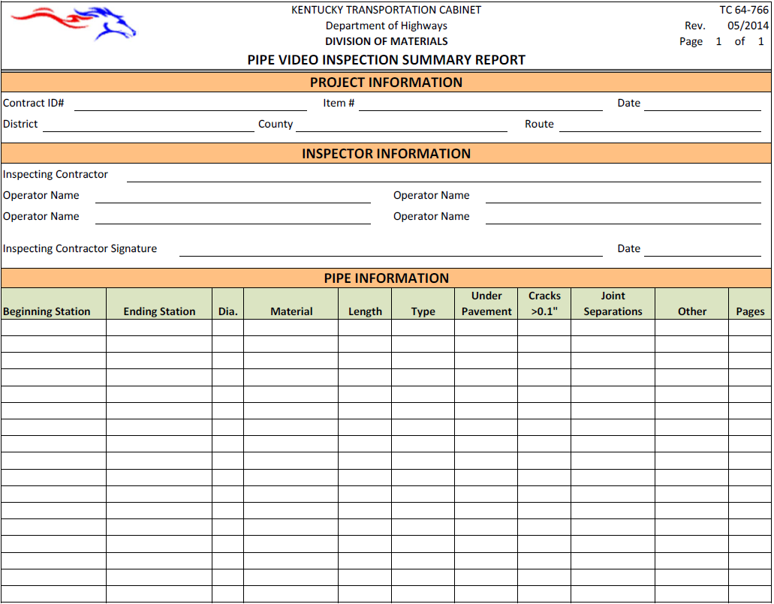
Video Inspection Summary Report – TC 64-766

Slide 10
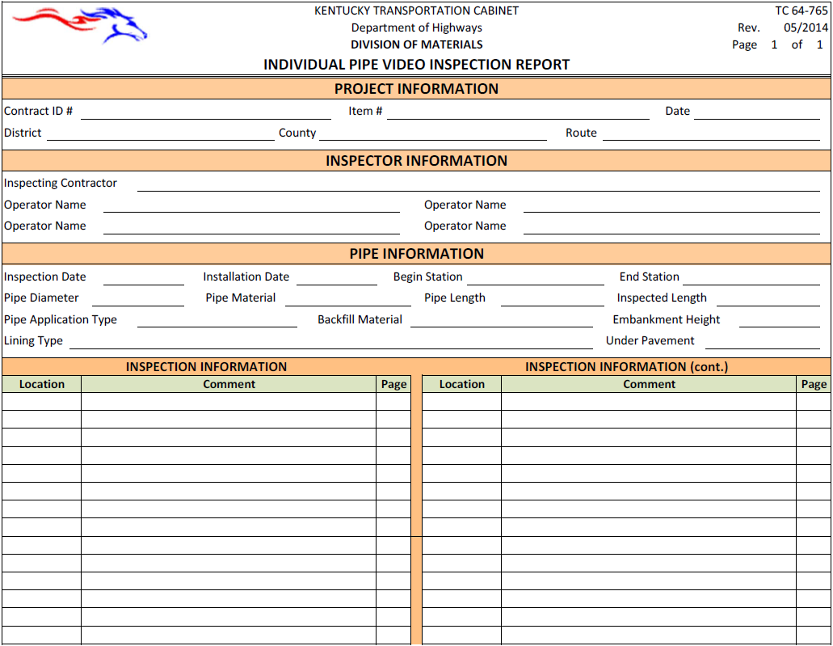
Individual Pipe Video Inspection Report – TC 64-765

Slide 11
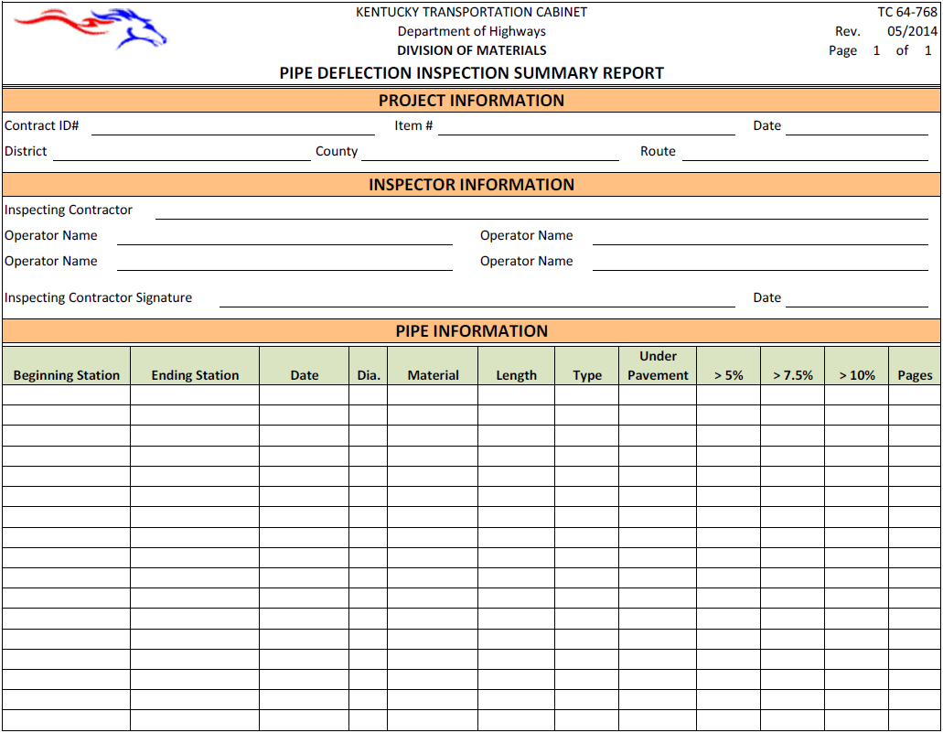
Deflection Inspection Summary Report – TC 64-768

Slide 12
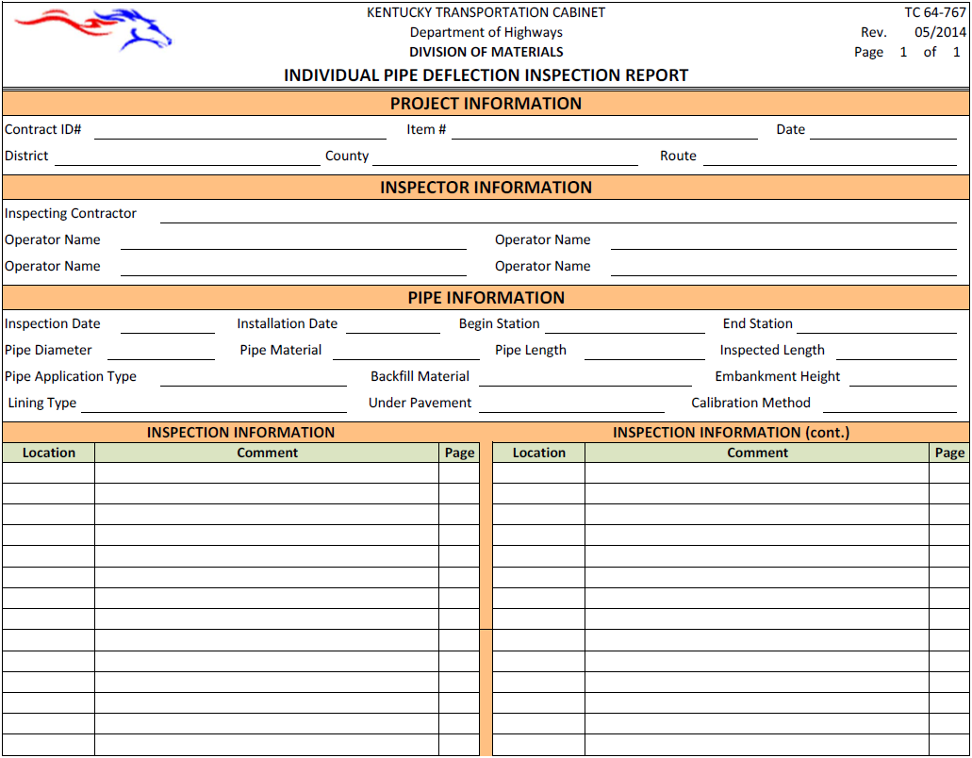
Individual Pipe Deflection Inspection Report – TC 64-767

Slide 13
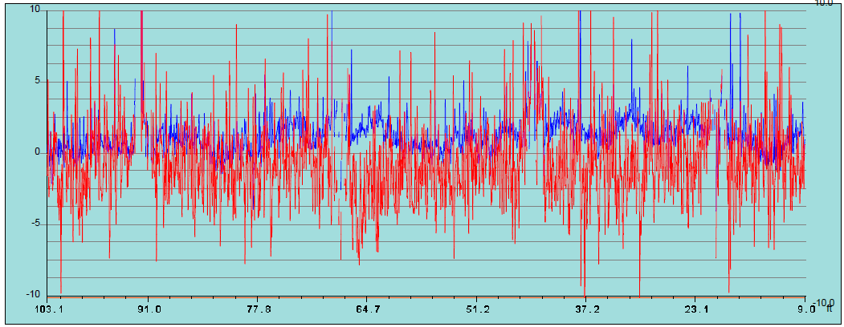
Example Profiles

Slide 14
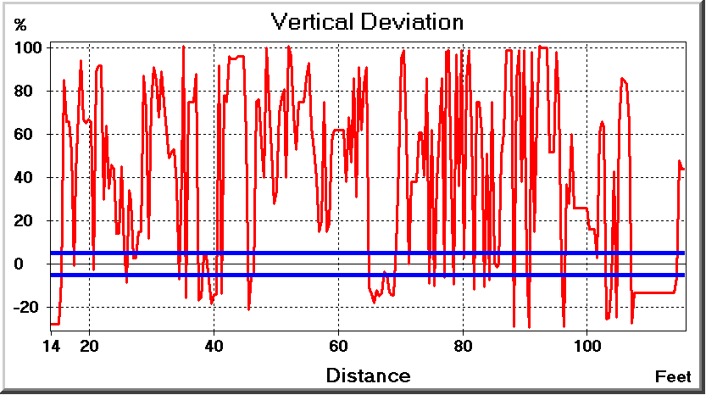
Example Profiles

Slide 15

Are deflection results in the ballpark?
$$\% def= \frac{Measured Dia. − Expected Dia.}{Expected Dia.} ∗100$$
Expected Dia. = Nominal or Mean or Base Dia.

Slide 16
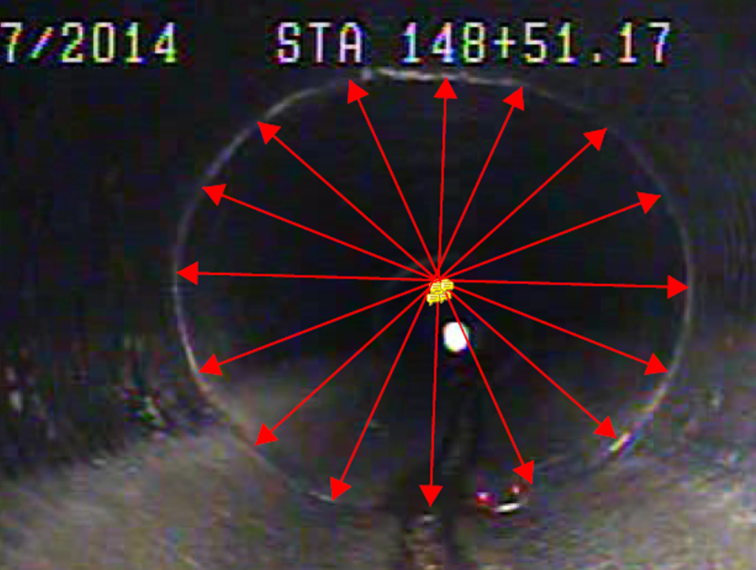
Check Deflections from Video
 | Meas. | Notes
 | (pts)
1 | 196.50 | Vert.
2 | 208.03
3 | 216.27
4 | 225.77
5 | 233.94 | Horz.
6 | 228.35
7 | 217.67
8 | 201.03
Mean | 215.95
Vert. Def. | -9.0 %
Horz. Def. | 8.3 %
1
5
Notes:
Use a joint in the video

Slide 17
Contractor Certification Program
Purpose: ensure the inspecting contractor can adequately identify and measure distresses and submit the appropriate documentation
Video inspection
Deflection inspection
Report requirements and submittal

Slide 18
Contractor Certification Program
1. Video inspection
Identify and catalog all distresses
Catalog all joint locations
Correctly determine longitudinal locations of all distresses
Determine widths of cracks and joint separations

Slide 19
Contractor Certification Program
2. Laser deflection measurement
Identify maximum deflections
Locations of all deflections
3. Inspection reports
Properly fill out all summary TC reports
Inclusion of video distress catalog software report
Inclusion of deflection software report

Slide 20
Contractor Certification Program
How?...we set up a test track
3 pipe types
HDPE
CMP
RCP
In-situ like distressed conditions
Modular w/ short sticks & RCP on skates so we can change the course

Slide 21
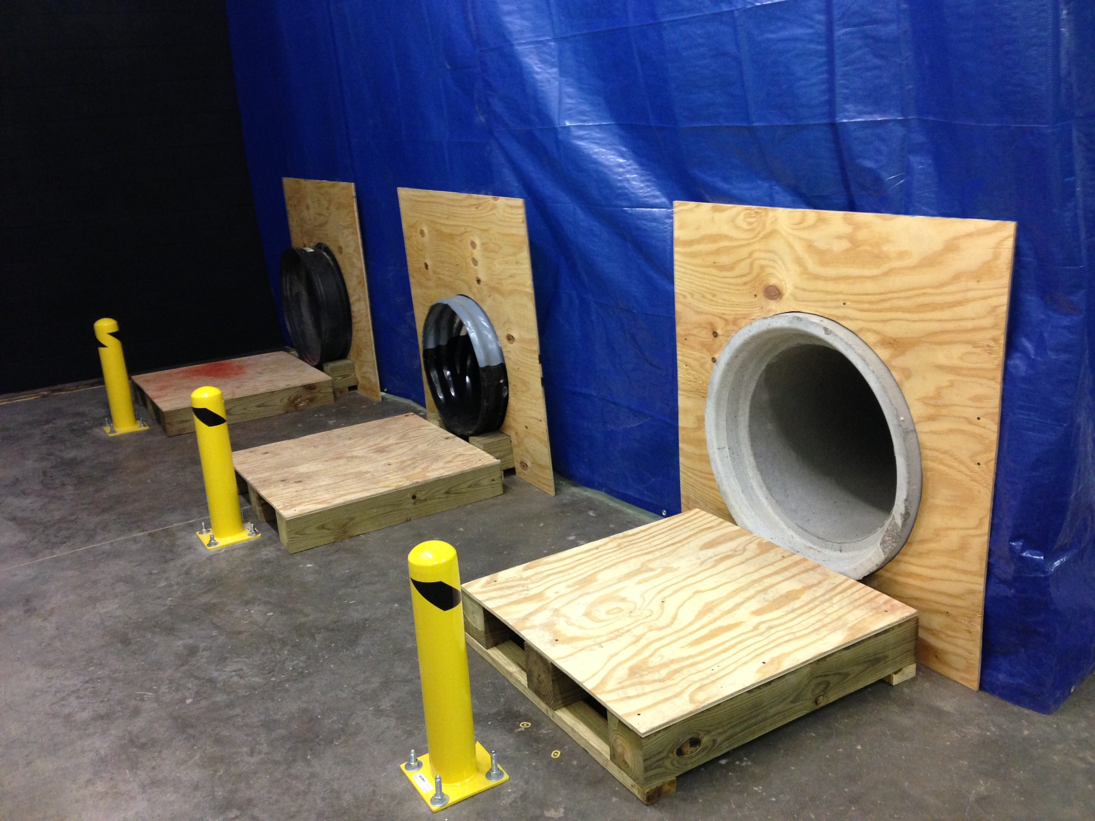

Slide 22
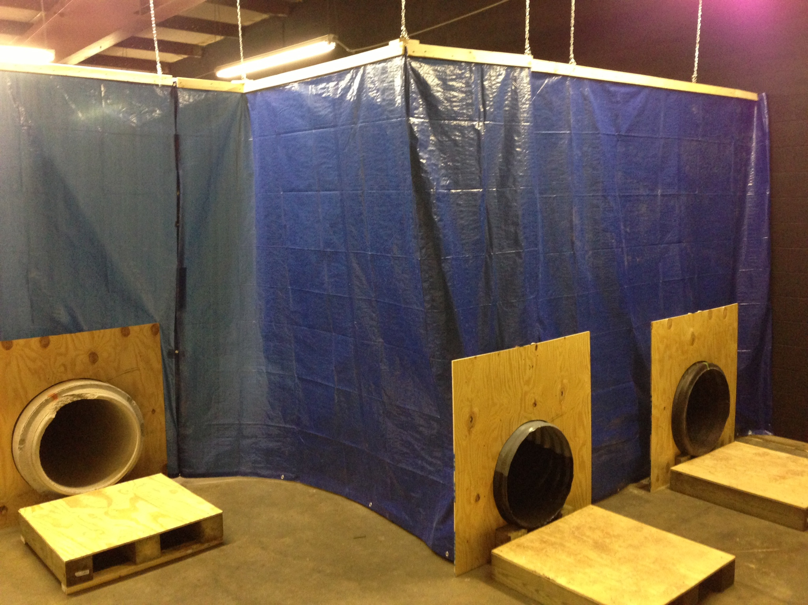

Slide 23
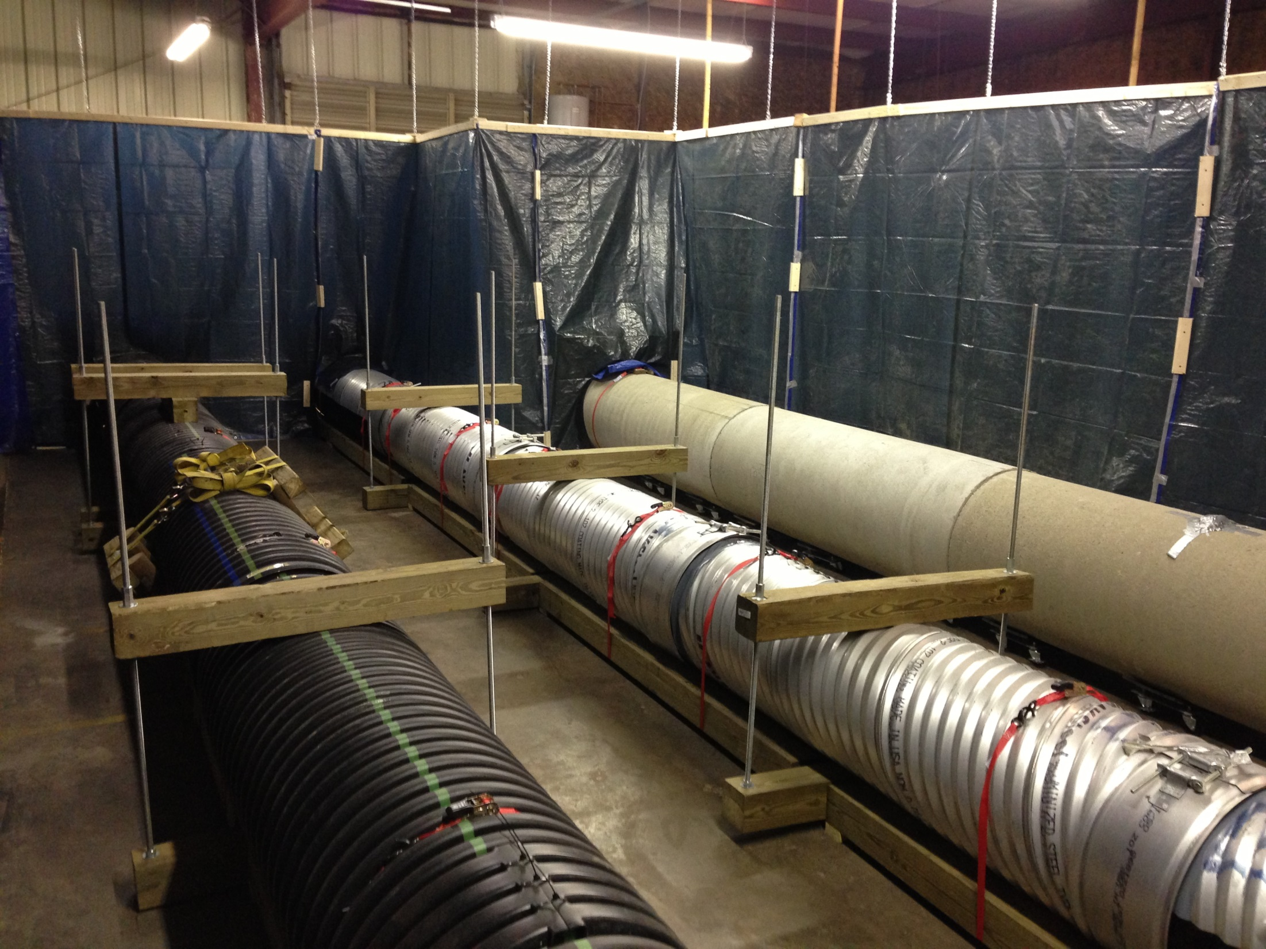

Slide 24
Contractor Certification Program
Contractor given 8 hours to perform inspections
7 business days to submit complete report
7 business days for KTC review and grade
Deflection results compared to our hand measurements
If contractor passes they will be issued a letter stating such and must be kept on-hand at all times

Slide 25
Thank You
More dates for training class will be announced shortly
If you have specific examples or questions please call anytime…we are here to help!!!
Kean H. Ashurst Jr., P.E.
Kentucky Transportation Center
University of Kentucky
176 Raymond Building
Lexington, KY 40506
(859) 257-7319
kean.ashurst@uky.edu

